Slide 1






Laser cooling and optical trapping of potassium with tunable interaction toward quantum gas production
Guan-Bo Liao
Advisor: Dr. Ming-Shien Chang
Co-Advisor: Dr. Szu-yuan Chen
Molecular Science and Technology (MST),
Taiwan International Graduate Program (TIGP), and National Central University

Slide 2
Outline
Motivation & challenges
Laser cooling of potassium
Optimization optical trapping of potassium
Interaction control of cold ³⁹K
Summary & outlook

Slide 3
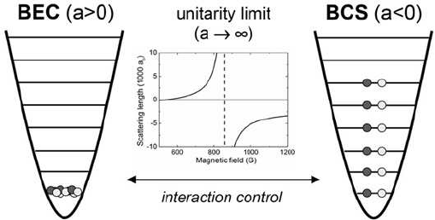
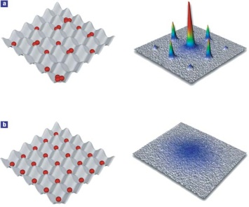
Motivation
Potassium quantum gas
Trapping all spin states:
³⁹K,⁴¹K(Spin-1 boson)
⁴⁰K(Spin-9/2 fermion)
Spinor condensates
Fermi degenerate gas
Fermi-Bose mixer
Tunable atomic interaction
Feshbach resonance in relatively low B field
Strong-interacting gas
Cold molecule formation
Few-body physics: Efimov states
Quantum simulation (with optical lattice)
Rb Spinor
m_{F} = 1
m_{F} = 0
m_{F} = -1
M. Chapman
R. Grimm
I. Bloch

Slide 4
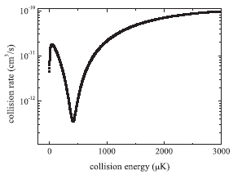
Challenges
Challenges
Narrow hyperfine structure (³⁹K & ⁴¹K, bad for laser cooling)
Negative scattering length (³⁹K, bad for evaporative cooling)
Notes:
這張 sly是我 stufying 的 Motivation
因為Ｐotassion 有三種不同的 isotope 其中有一種是fermion 所以我們希望能產生所有種類的BEC 並且去Studying spinor
我希望我們的系統可以去 tune potassium的 scattering length
一但我們能做到這件事，我們就可以 studying 一些 few-body的 problem 比如說 Efimov State。

Slide 5
Challenges
Challenges
Narrow hyperfine structure (³⁹K & ⁴¹K, bad for laser cooling)
Negative scattering length (³⁹K, bad for evaporative cooling)
Solutions
Better laser cooling
better detuning control for sub-Doppler cooling
Ground-state cooling
Tuning scattering length via Feshbach resonances
All-optical formation of potassium Bose-Einstein Condensates
Simple and fast
Optical trap is essential for spinor studies
Optical trap is essential for Feshbach resonance
Notes:
這張 sly是我 stufying 的 Motivation
因為Ｐotassion 有三種不同的 isotope 其中有一種是fermion 所以我們希望能產生所有種類的BEC 並且去Studying spinor
我希望我們的系統可以去 tune potassium的 scattering length
一但我們能做到這件事，我們就可以 studying 一些 few-body的 problem 比如說 Efimov State。

Slide 6
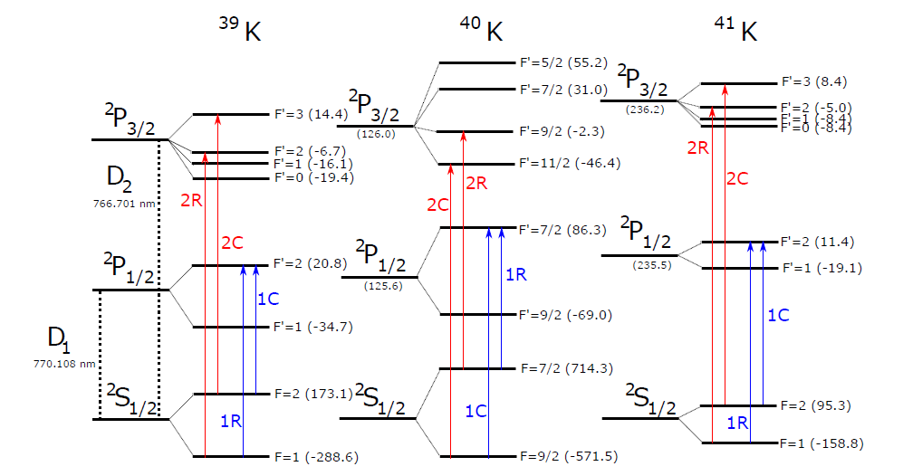
93%
0.01%
7%
Ref: M. Tarnowski, Thesis (2015).

Slide 7
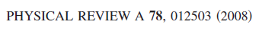
The scattering property of Potassium
Isotope | Scattering Length (a_{t}) | Scattering Length (a_{s})
39/39 | -33.48 (18) | 138.49 (12)
39/40 | -1985 (69) | -2.84 (10)
39/41 | 177.10 (27) | 113.07 (12)
40/40 | 169.67 (24) | 104.41 (9)
40/41 | 97.39 (9) | -54.28 (21)
41/41 | 60.54 (6) | 85.53 (6)

Slide 8
History of Ultrcold K
1999 ⁴⁰K Degenate Fermi gas (first DFG, Jin, JILA)
2001 ⁴¹K BEC by sympathetic cooling with Rb atoms as the coolants (Ingusio, LENS)
2003 Molecular BEC of ⁴⁰K (Jin)
2007 ³⁹K BEC by sympathetic cooling with Rb atoms as the coolants (Ingusio)
2011 D₂ line Sub-Doppler cooling T = 25 μK (Ingusio)
³⁹K BEC in an optical dipole trap (loaded from a magnetic trap) (Ingusio)
2017 Degenerate Raman sideband cooling T = 1.8 μK (Neigor, Innsbruck)

Slide 9
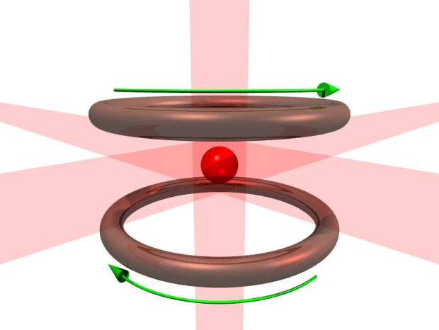
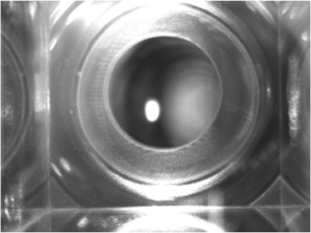
Our experimental approach
σ⁻
m_{j}
m_{j}
σ⁺
σ⁻
-1
E
1
J = 1
0
Δ
0
1
-1
σ⁺
σ⁻
σ ⁺
ω_{l}
σ ⁻
σ⁺
J = 0
J = 0
z
Magneto-Optical trap
(MOT, the bright spot)
Notes:
這兩張圖片是簡單的MOT和Dipole trap 的示意圖 左邊這張圖是MOT,中間這個小白點就是被磁光井限至住的 cold atom 右邊就是把cold atom 在進一步 load 到dipole trap 裡 ，我們大部分的實驗都是從把原子load到Dipole 開始

Slide 10
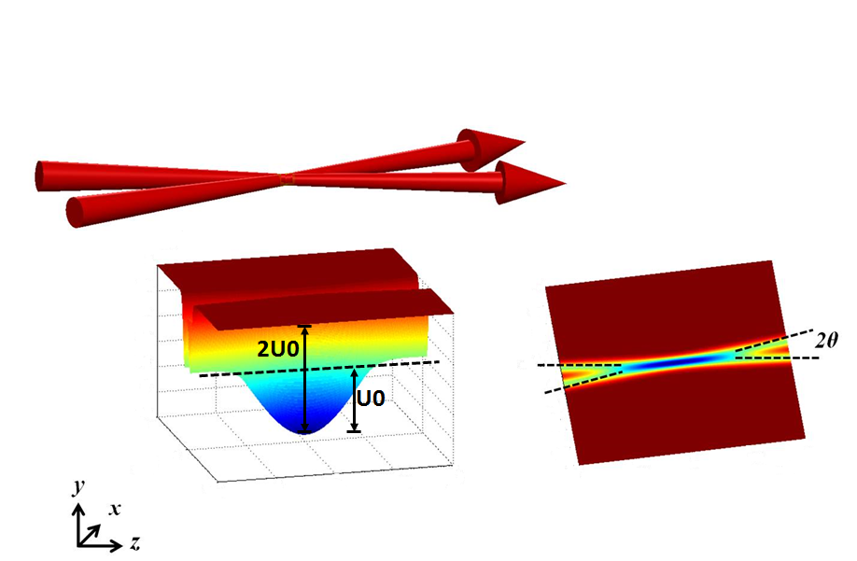
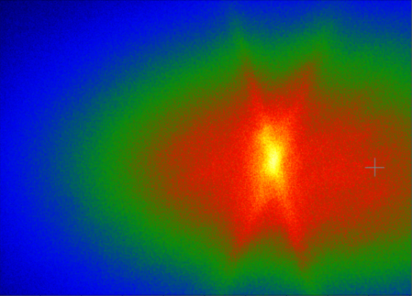
Our experimental approach
σ⁻
σ⁺
σ⁻
σ⁺
σ⁻
σ⁺
Sub-Doppler Cooling
CMOT, n > 10¹⁰ cm⁻³
TDMOT, T ~ 50 μK
GMS, T ~ 10 μK
RSC, T ~ 2 μK
Magneto-Optical trap
(MOT, the bright spot)
Optical dipole trap
(ODT, overlapped with MOT)
Notes:
這兩張圖片是簡單的MOT和Dipole trap 的示意圖 左邊這張圖是MOT,中間這個小白點就是被磁光井限至住的 cold atom 右邊就是把cold atom 在進一步 load 到dipole trap 裡 ，我們大部分的實驗都是從把原子load到Dipole 開始

Slide 11
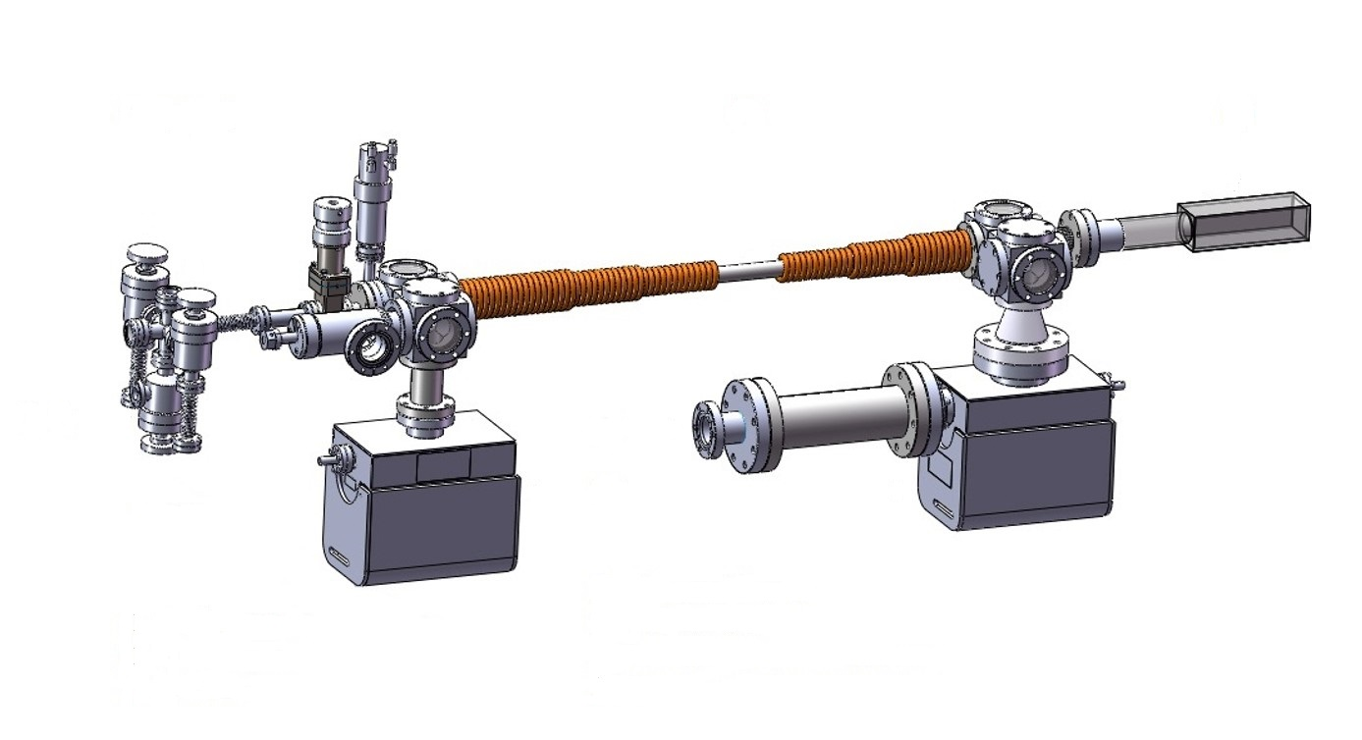
Vacuum system
Zeeman slower for ⁸⁷Rb, ⁸⁵Rb,³⁹K, ⁴⁰K, ⁴¹K
UHV glass cell for quantum gas experiments
PMT
K
Slower Tube
Slower Lasers
Rb
Probing Laser
Trans Cooling
TSP
Ion Pump
Ion Pump
Ion Pump
Notes:
二種原子
用飽合吸收光譜當reference 確認有低速度群的原子群被冷下來

Slide 12
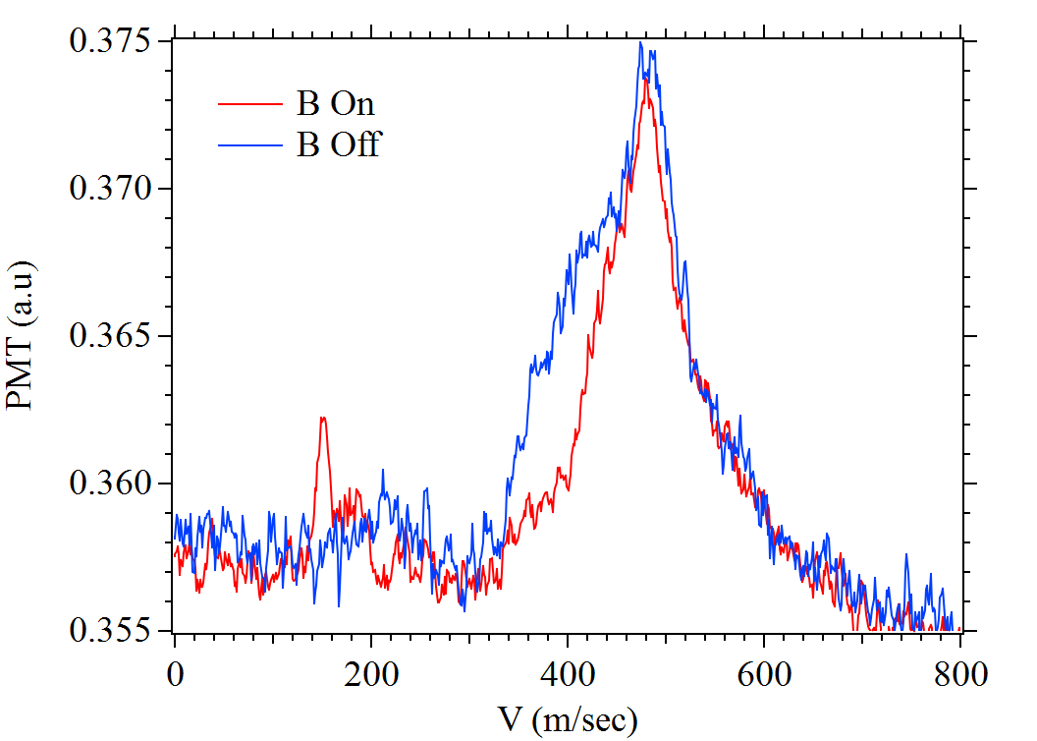
Cold atomic beam
T_{oven} = 150º C
Slower Laser on
480 m/sec
153 m/sec

Slide 13
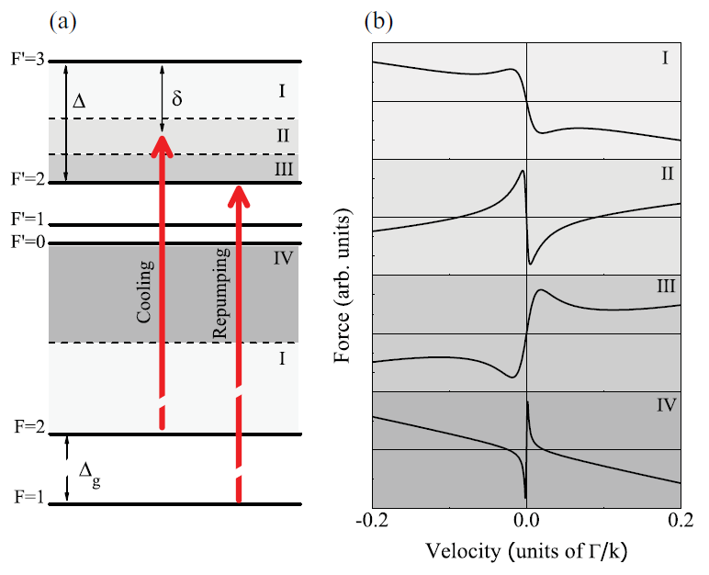
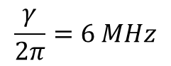
Sub-Dopplor cooling of Potassium
(+14.4MHz)
33.6 MHz
(-6.7MHz)
(-16.0MHz)
(-19.2MHz)
$$\frac{γ}{2π}=6 MHz$$
(+173.1MHz)
(-288.6MHz)
Landini et al., PRA 84, 043432 (2011)
Notes:
Sub-Doppler effect only exists in domain II
首先 hyperfine 很窄 LASER cooling 跟HEATING 的關系變得很complex
2 4 象限是 Cooling 1 3象限是 heating SubDoppler 存在在 Rean II Optical Force 跟VELOCITY成恢復力的聯系

Slide 14
Sub-Dopplor cooling of Potassium
- Temporal Dark MOT + Cooling Beam Frequency Shift
T ~ 550 μK
T ~ 50 μK

Slide 15
Our experimental approach
σ⁻
σ⁺
σ⁻
σ⁺
σ⁻
σ⁺
Sub-Doppler Cooling
CMOT, n > 10¹⁰ cm⁻³
TDMOT, T ~ 50 μK
GMS, T ~ 10 μK
RSC, T ~ 2 μK
Magneto-Optical trap
(MOT, the bright spot)
Optical dipole trap
(ODT, overlapped with MOT)
Notes:
這兩張圖片是簡單的MOT和Dipole trap 的示意圖 左邊這張圖是MOT,中間這個小白點就是被磁光井限至住的 cold atom 右邊就是把cold atom 在進一步 load 到dipole trap 裡 ，我們大部分的實驗都是從把原子load到Dipole 開始

Slide 16
Our experimental approach
σ⁻
σ⁺
σ⁻
σ⁺
σ⁻
σ⁺
Sub-Doppler Cooling
CMOT, n > 10¹⁰ cm⁻³
TDMOT, T ~ 50 μK
GMS, T ~ 10 μK
RSC, T ~ 2 μK
Magneto-Optical trap
(MOT, the bright spot)
Optical dipole trap
(ODT, overlapped with MOT)
Notes:
這兩張圖片是簡單的MOT和Dipole trap 的示意圖 左邊這張圖是MOT,中間這個小白點就是被磁光井限至住的 cold atom 右邊就是把cold atom 在進一步 load 到dipole trap 裡 ，我們大部分的實驗都是從把原子load到Dipole 開始

Slide 17
Outline
Motivation & challenges
Laser cooling of potassium
Optimization optical trapping of potassium
Interaction control of cold ³⁹K
Summary & outlook

Slide 18
The Principle of Optical Trapping
E
+
-
Trapping with electric fields
Neutral atoms
E- field induces electric dipole
Induced dipole attracted to regions of high field
Use focused laser beams
Spontaneous photon scattering causes heating
Use far off-resonant laser, e.g.,
+
+
-
α, atomic
polarizability
Force
E- field maximum
Focused laser beam
conservative trap
Notes:
Optical Trapping 是用電磁場去透發原子的dipole moment

Slide 19
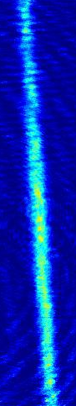
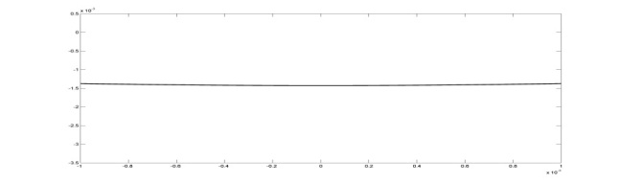
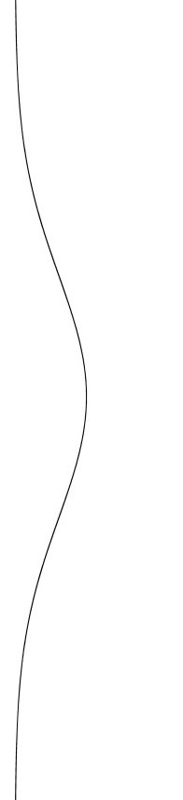
Optical Trap: CO₂ v.s Nd:YAG
Atom Source: K
Atom Source: Rb
Nd:YAG laser
w₀ = 90 μm
CO₂ laser
(f_{x} , f_{y} , f_{z} ) =
(2090, 2090, 152) Hz
N= 2.3×10⁵
T_{d} = 120 μK
(f_{x} , f_{y} , f_{z})= (730, 730, 2)Hz
Notes:
這邊有個歷史的因素要先提一下，
1 CO2 LASER 最大的缺點是CO2無法穿過一般的玻璃 所以要用金屬的真空腔 或者要用特書的 才料去做WINDOW

Slide 20
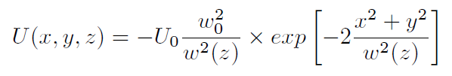
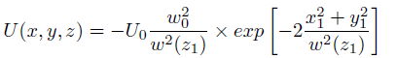
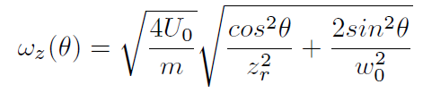
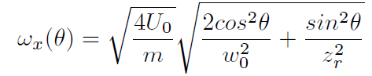
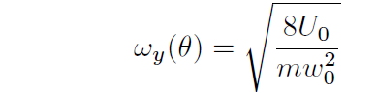
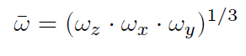
Crossed Optical Dipole Trap Design
Cross Nd:YAG laser beams to simulate a single focused CO₂ laser beam
Enhance axial confinement
Single-beam potential
Trapping Frequencies of 2XODT
Liao et al., JOSA B (2017)

Slide 21
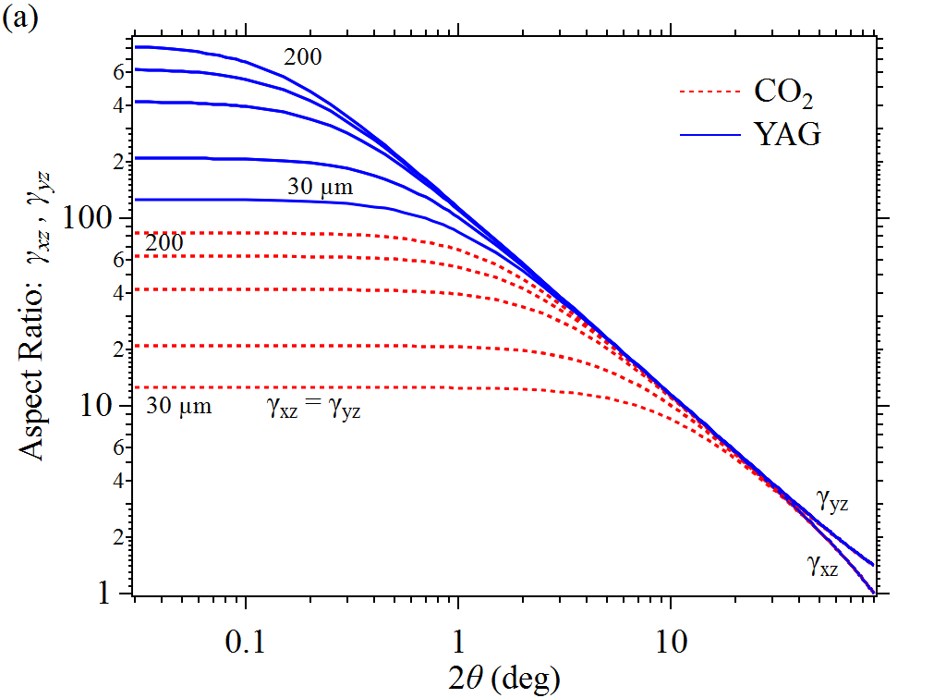
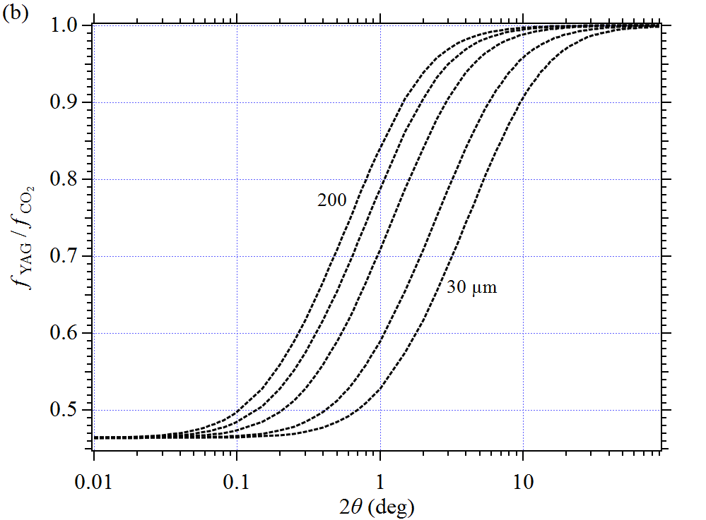
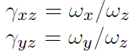
Dipole trap engineering
Aspect ratio (γ_{xz} , γ_{yz}) is insensitive to λ when 2θ > 10°

Slide 22
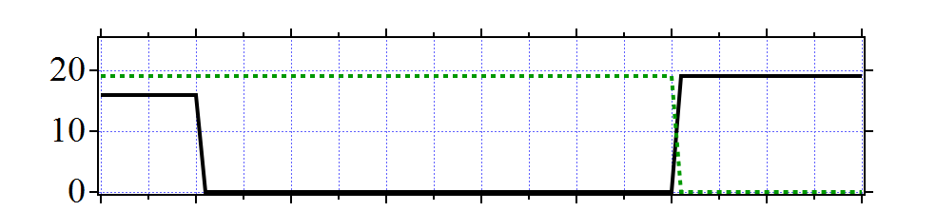
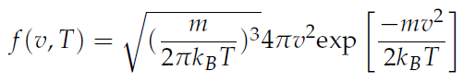
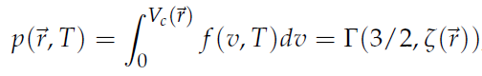
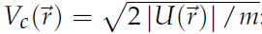
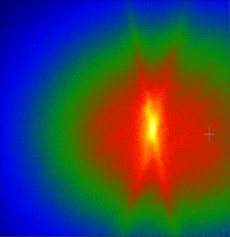
ODT On
Simple Loading Model
MOT Off
Cutoff Velocity
Maxwell Boltzman Distribution
Cutoff Velocity
MOT Density Distribution

Slide 23
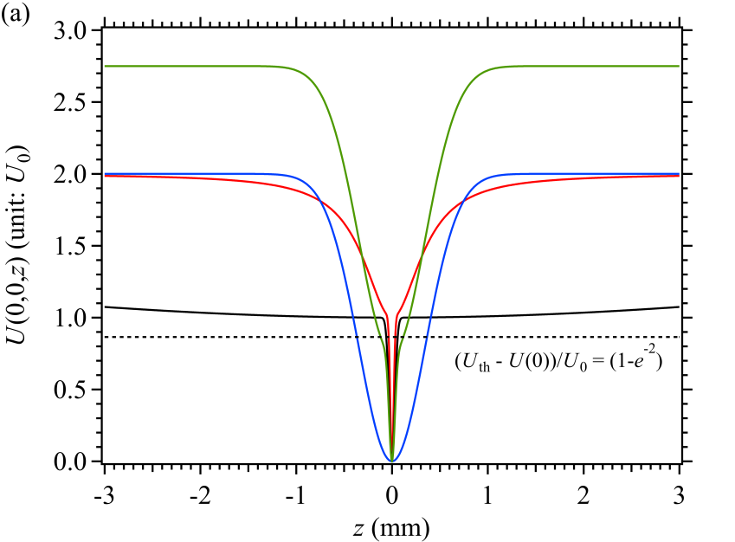
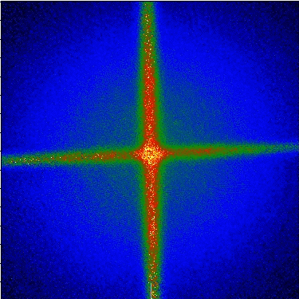
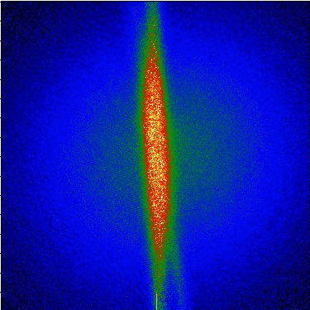
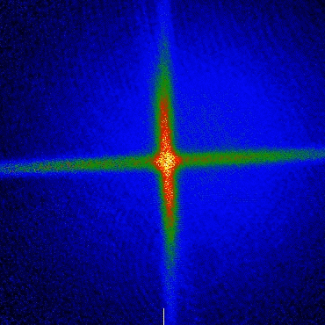
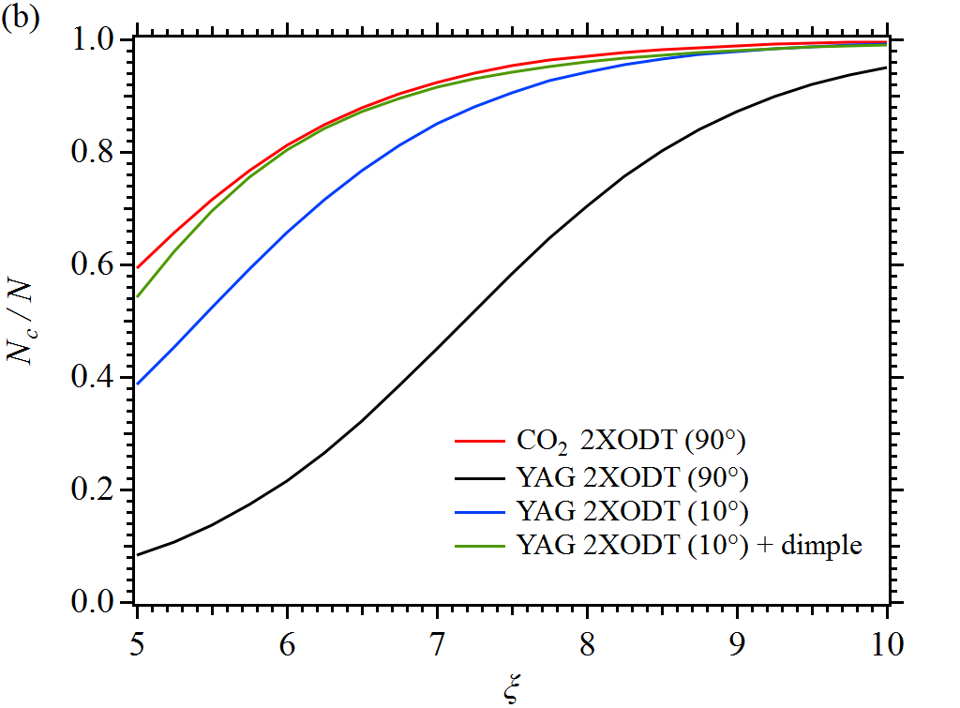
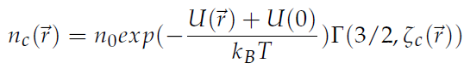
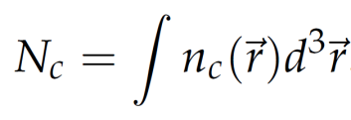
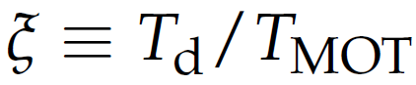
Number of atoms in the dimple region
- High center fraction benefit for evaporation cooling
Rb & Nd:YAG ODT
2X ODT (90⁰)
2X ODT (10⁰)
2X ODT (10⁰) + dimple
Huang et. al, 2017

Slide 24
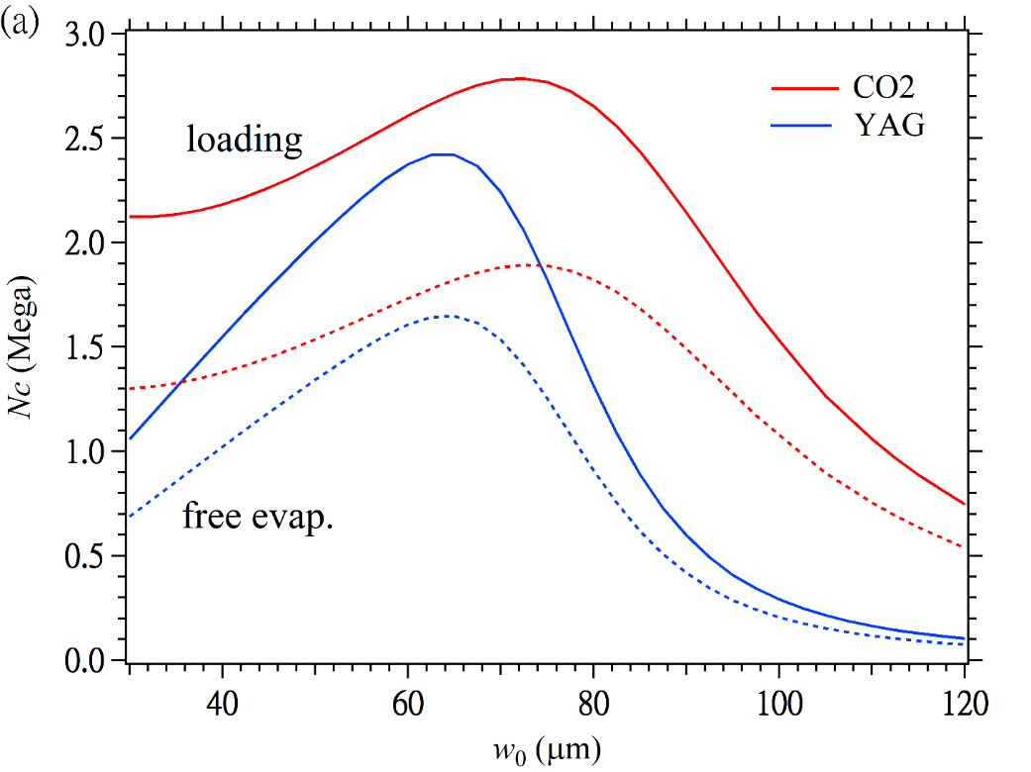
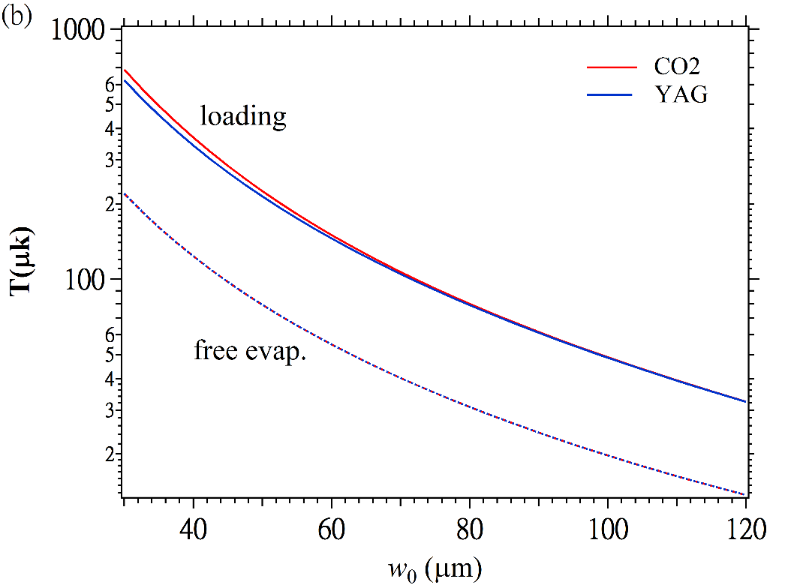
Atom number and temperature in the center before and after free evaporation
-Power limited: 10W per beam
N: 2x10⁸
T_{MOT} = 30μk
n₀ = 10¹¹ cm⁻³

Slide 25
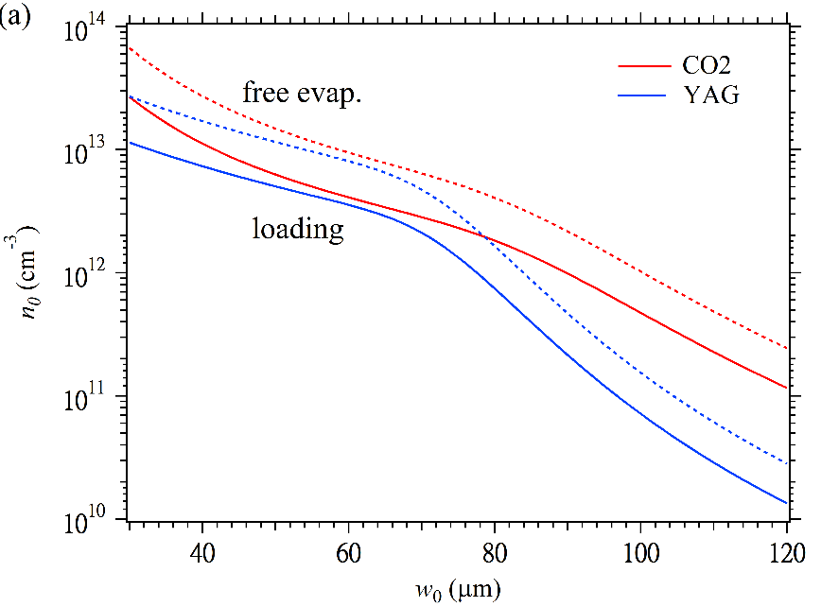
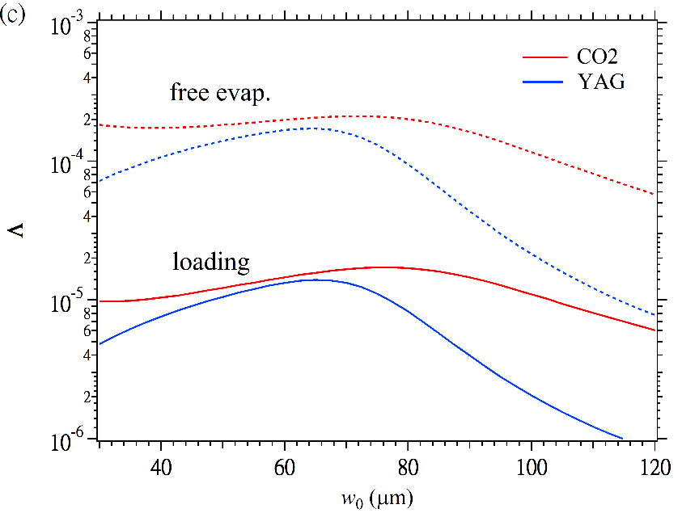
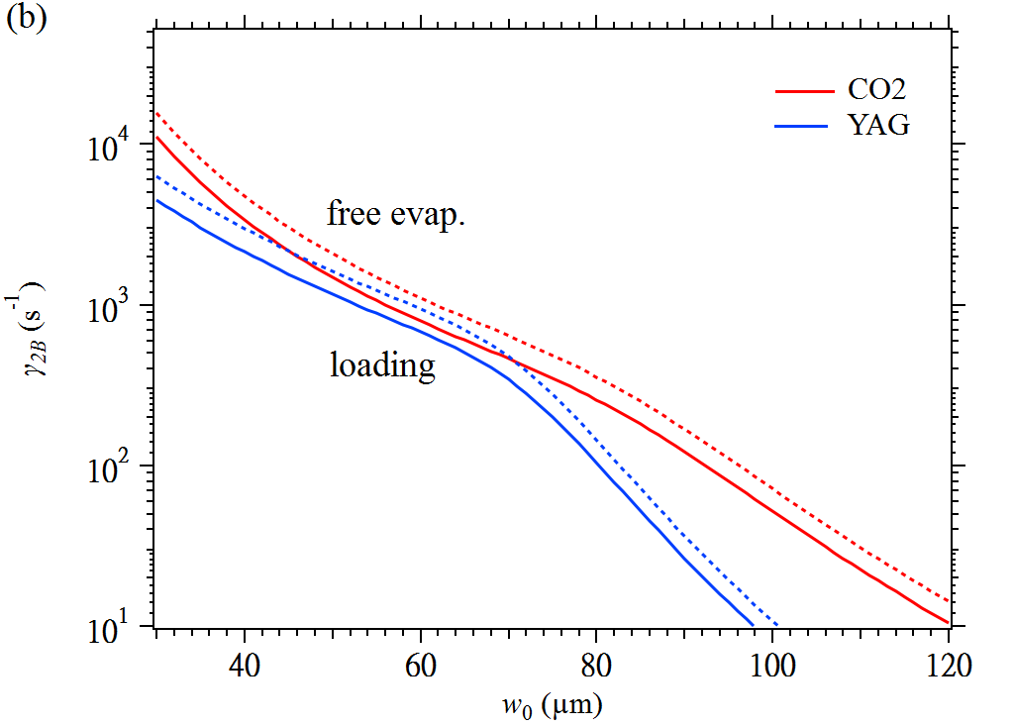
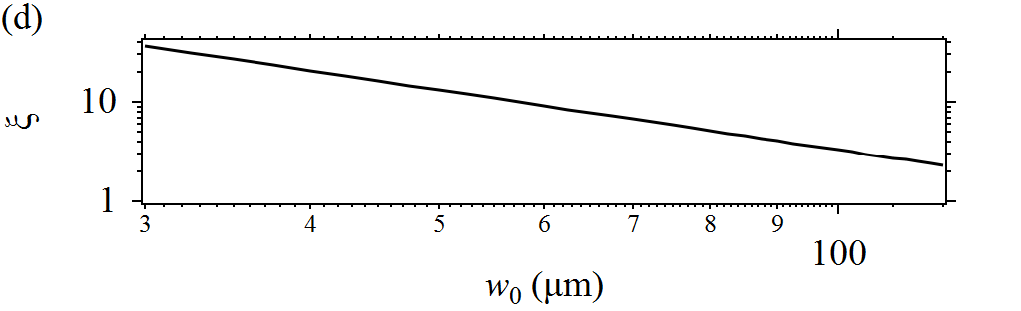
Simulation of cloud properties
Power : 10 W/beam

Slide 26
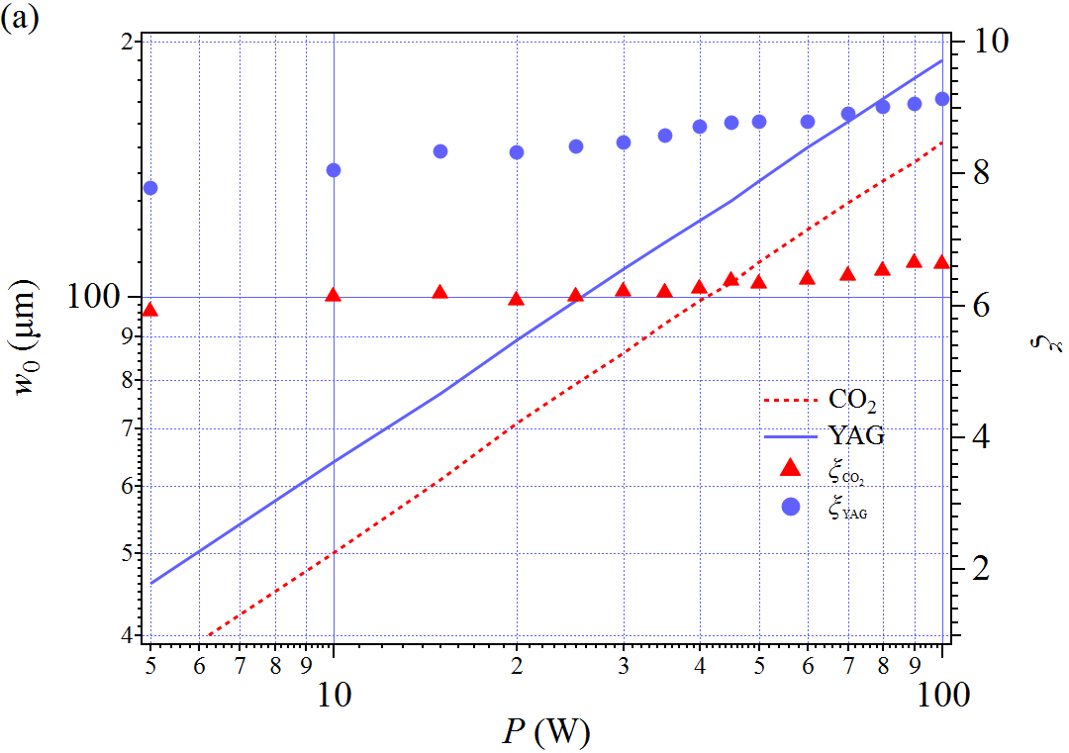
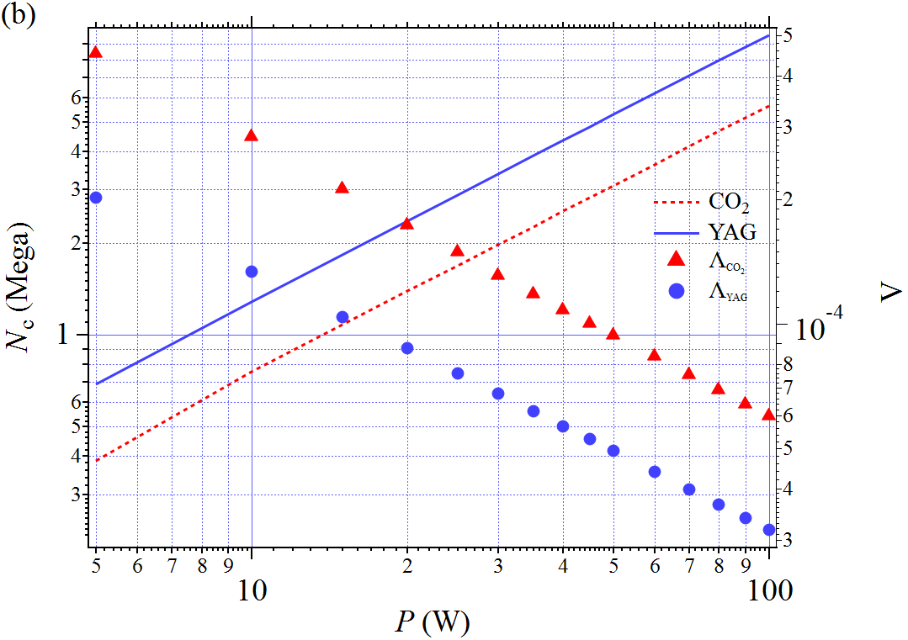
Optimization condition
- Best Phase Space Density from 5W to 100W

Slide 27
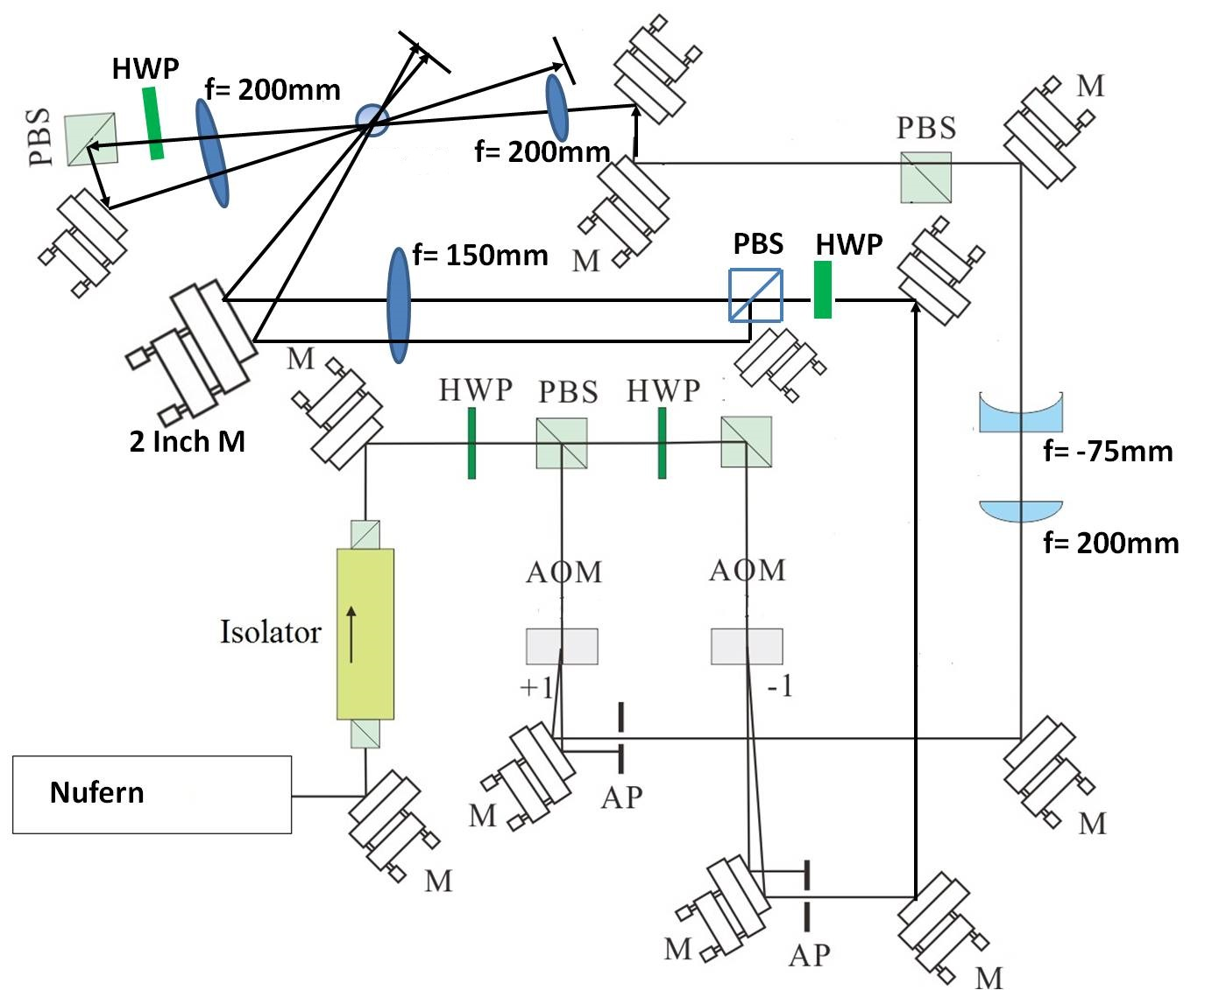
Dipole laser system
MOT

Slide 28
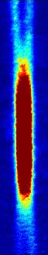
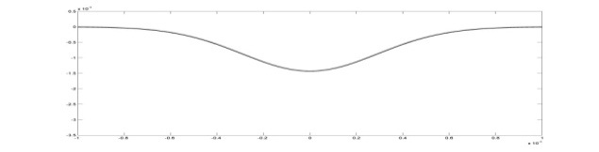
Optical Trap: CO₂ v.s Nd:YAG
Atom Source: K
Atom Source: Rb
w₀ = 90 μm
CO₂ laser
(f_{x} , f_{y} , f_{z} ) =
(2090, 2090, 152) Hz
N= 2.3×10⁵
T_{d} = 120 μK
N= 1.3×10⁶
T_{d} = 240 μK
(f_{x} , f_{y} , f_{z})= (730, 730, 2)Hz
(f_{x} , f_{y} , f_{z})= (710,710,50)Hz
Notes:
這邊有個歷史的因素要先提一下，
1 CO2 LASER 最大的缺點是CO2無法穿過一般的玻璃 所以要用金屬的真空腔 或者要用特書的 才料去做WINDOW

Slide 29
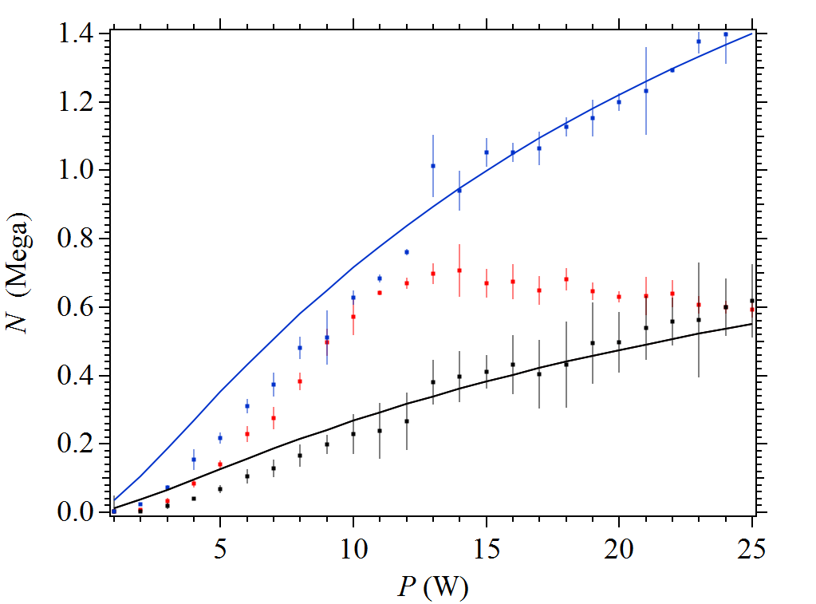


Loading of Nd:YAG optical dipole trap
MOT Off
Notes:
回答為什麼磁井為什麼Loading不好

Slide 30

Best condition of optical dipole trap
Parameters
P = 63.8 W
w₀ = 90 μm
w₀ = 68 μm (dimple pair)
T_{d} = 740 μK
f = 1000 Hz
N = 2.2 Mega
T = 40 μK
Trap lifetime τ = 6.8 sec

Slide 31
Outline
Motivation & challenges
Laser cooling of potassium
Optimization optical trapping of potassium
Interaction control of cold ³⁹K
Summary & outlook

Slide 32

Molecular Potential of ³⁹K₂

Slide 33

S-wave scattering length
Phase Shift After Collision
Most Important Parameter
Intercept of Nonperturbed Wave Function
³⁹K
a_{t}
-33 a₀
a
a_{s}
138 a₀
Notes:
s wave scattering length cold atom是最重要的物理參數，它代表了原子碰撞前後的phase shift

Slide 34

S-wave scattering length
Phase Shift After Collision
Most Important Parameter
Intercept of Nonperturbed Wave Function
³⁹K
a_{t}
-33 a₀
a
a_{s}
138 a₀
Notes:
s wave scattering length cold atom是最重要的物理參數，它代表了原子碰撞前後的phase shift

Slide 35

Tuning the scattering length –
one-channel model
Step Potential (Repulsive)
V(r) = 0, r > r₀
V(r)= V₀ , r< r₀
Notes:
We can use a simple model to observe how scattering length changing with interaction potential
First of all, simply two atom interaction with a step potential function，For replusive interaaction

Slide 36








Tuning the scattering length –
one-channel model
Step Potential (Attractive)
$$E ≈ 0$$
Notes:
For attractive potential, the result becomes very interesting. The scattering length is a tangent term changing with trap depth’s potential. And the diverging position is a bound-state generation inside the potential well.

Slide 37








Tuning the scattering length –
two-channel model
- Two-channel model: open and closed channels
- Atom comes in via the open channel
- Scattering length tuned by a nearby bound-state in the closed channel
B
Open Channel
E_{conti}
E_{C}
r₀
Close Channel
: Coupling Strength
B
Open Channel
E_{conti} = E_{c}
r₀
Close Channel
Notes:
也可以加入一個scattering channel 去調操 scattering length，原本的 channel 我們稱為open channel，新加入的channel 我們稱為close channel ，可以用close channel 的bound state去調操scattering length。

Slide 38

Magnetic Feshbach resonance
- Two alkali atoms scatter into a meta-stable molecular state and decay back to two free atoms
- Open Closed Open
B
Space
Time

Slide 39

Magnetic Feshbach resonance
- Two alkali atoms scatter into a meta-stable molecular state and decay back to two free atoms
- Triplet Siglet Triplet
B
∆
∆ < 0

Slide 40

Scattering length and cross section
∆
∆ < 0
→ Tunable interaction:
attractive/repulsive
non/strongly interacting
Ref: C. Chin, PhD thesis (2001).
Notes:
首先我們先來看第三張
a_s與磁場的關係可以以這個公式表示
B0>\Delta B>a_bg
a_s=0至發散處的磁場位移
Coupling Strength = \Delta B
Atomic interaction dominated by ultracold collisions which is parameterized by the s-wave scattering length a, $U=\frac{{4πℏ}^{2}a}{m}$

Slide 41



Asymptotic bound-state model (ABM)
- Easy to Estimate Resonance Position
- Ex: F=1, mf=1
³⁹K
Notes:
實際上的計算，我們可以用ABM 而且以F=1 mf=-1來說明

Slide 42




Bare and dressed Feshbach resonacne
³⁹K
Hamiltonian
V_{h}: Coupling Strength
Dressed State Energy
Notes:
Bare: Close Channel Dominate

Slide 43

Cold molecular formation
- Adiabatic Ramp from Negative Side from Positive Side
³⁹K
B Field Ramp

Slide 44




Efimov State
¹³³Cs
Trimer: a < 0
³⁹K

Slide 45
Application of Feshbach resonance
․Quantum (ultracold) matter with tunable interaction
-between attractive and repulsive
-between non-interacting and strongly interacting
․ Simulating condensed matter: BEC-BCS crossover
․ Simulating few-body physics: Efimov physics
․ Molecule formation: Feshbach molecules
․ Coherent control of atomic interactions for implementation of a
quantum entangling gate
Notes:
Explicitly speak out the applications

Slide 46


Feshbach spectroscopy of ³⁹K
- Atom Loss & Temperature Drop
- Inter-spin and Intra-spin State
(10³)

Slide 47

Feshbach spectroscopy of ³⁹K
- Atom Loss & Temperature Drop
- Inter-spin and Intra-spin State
(10³)
113.7
40.7
25.9
524.2
75.2
491.6
?
472.8

Slide 48


Spin population control by radio frequency (RF)

Slide 49
Spin editing by RF & laser beam
F’
F’
Cooling Beam
F=2
F=2
RF
F=1
F=1

Slide 50


Spin editing by RF
F’
m_{f} =1
m_{f} = -1
Cooling Beam
m_{f} =0
F=2
Clock Frequency
F=1

Slide 51





Hybrid magnetic trap and ODT
Magnetic Trap ; Grading: 50.3 G/cm
Magnetic Trap & Dipole Trap
Optical Dipole Trap
N: 15 Mega
mf=-1 N: 250 k
Without Magnetic Trap Compressing

Slide 52




Two body and three body collision enhancement
- Reverse Scattering Length Curve
- Interesting Atom Loss
- Efimov State Conjecture
B₀: 33.6 G
Notes:
1，留在Dipole Trap 裡的atom數目增加表示有效的碰撞被增強

Slide 53
Two body and three body collision enhancement
- Reverse Scattering Length Curve
- Interesting Atom Loss
- Efimov State Conjecture
B₀: 33.6 G
Notes:
1，留在Dipole Trap 裡的atom數目增加表示有效的碰撞被增強

Slide 54

Two body and three body collision enhancement
- Negative Side to Positive Side
- Feshbach Molecular Conjecture
B₀: 33.6 G

Slide 55

Toward quantum gases
Best PSD 7*10⁻³ N: 17000
~ 1

Slide 56




Slide 58

New Vacuum System
- Vacuum problem
- Two Isotope Dispenser: ³⁹K , ⁴¹K (7%), ⁴⁰K(0.01%)
- Gray-molasses Cooling

Slide 59

Ground-state cooling
Gray-molasses Cooling
Energy lost
Bright molasses
Gray molasses
Ref: M. Tarnowski, Thesis (2015).

Slide 60



Ground-state cooling – Gray-molasses
Add molasses cooling
Energy lost
Ref: M. Tarnowski, Thesis (2015).

Slide 61

Gray-molasses cooling
EPL 104, 63002 (2013)
Ref: M. Tarnowski, Thesis (2015).
Notes:
Mf=-2, -1, 0,….
S+光…

Slide 62
Cooling improvement by Gray-molasses
D₂ Sub-Dopplor Cooling
D₁ Gray-molasses Cooling
N ~ 7 Mega T ~ 30 μK
N ~ 12 Mega T ~ 10 μK

Slide 63
Old System
New System

Slide 64
Summary
Laser cooling, trapping and force evaporation of ³⁹K
- best PSD 7*10⁻³ , N: 17000
Feshbach resonance of ³⁹K
- inter-spin state (no experimental report)
Spin state control of ³⁹K
Formation of Efimov and Feshbach molecules

Slide 65

Outlook
Inter-spin state Efimov & Feshbach molecular
Toward quantum gases ³⁹K & ⁴¹K
Quantum gases by laser cooling
Raman sideband cooling & compressing
Two-chamber system: 2D⁺ + 3D MOT
Atom synthesizer
arXiv:1705.03421v1

Slide 66


Acknowledgement
吳耿碩(博士)
鄭毓璿
劉修源
黃智遠
陳俊嘉
彭有宏
蔡孟儒
池亮穎
施中右
張銘顯 老師
黃宣凱
吳敏瑄
魏奇勳
孫立安
張雅婷
林玟晨
黃孝智(博士)
林育如 (老師)
鐘朝益 (先生)
吳水源 (先生)
陳賜原 (老師)
Thanks for your attention!

Slide 69



Slide 70


Slide 71


Elastic and Inelastic Collision
Ref: C. Chin, PhD thesis (2001).

Slide 73


Slide 74
F’=3
F’=2
F’=1
m_{j}
m_{j}
-1
E
1
F’=0
J = 1
0
Δ
0
Cooling Beam
1
-1
σ ⁺
ω_{l}
σ ⁻
Repumping Beam
J = 0
J = 0
z
F=2
F=1

Slide 75


Slide 76





Gray-molasses Cooling
$$V_{mot}≅ℏkv$$
$Γ^{′}=$Optical pumping rate from$\left.\left|ψ_{B}\right.\right\rangle$ to$\left.\left|ψ_{D}\right.\right\rangle$
$τ≥$1/$Γ^{′}$
Energy lost
Staying time: $τ≈1/kv⇒kv≤Γ^{′}⇒v≤\frac{Γ^{′}}{k}$
Capture velocity: $v_{c}≅Γ^{′}/k$
Slow atoms are accumulated in dark states
$Γ^{′}∝I/δ^{2}$, so $v_{c}$ increase with $I$
Ref: M. Tarnowski, Thesis (2015).
Notes:
v: velocity of the atom, k: wave vector

Slide 77












Dark state and Dressed states
$$H=H_{0}+V$$
$$V=\frac{ℏ}{2}(Ω_{g}\left|\left.e\right\rangle \left\langle g\right.\right|+Ω_{r}\left|\left.e\right\rangle \left\langle r\right.\right|+H.c.)$$
$$\left.H_{0}=ℏΔ(\left|\left.g\right\rangle \left\langle g\right.\right|+\left|\left.r\right\rangle \left\langle r\right.\right|\right)$$
$$\left.\left|ψ_{D}\right.\right\rangle =\frac{1}{Ω}\left(Ω_{r}\left.\left|g\right.\right\rangle −Ω_{g}\left.\left|r\right.\right\rangle \right), Ω=\sqrt{{Ω_{g}}^{2}+{Ω_{r}}^{2}}$$
$λ_{D}=$ $∆$
$$\left.\left|ψ_{+}\right.\right\rangle =cosθ\left.\left|e\right.\right\rangle +sinθ\left.\left|ψ_{C}\right.\right\rangle$$
$λ_{+}=$ $∆+δ$
$$tanθ=\frac{\sqrt{∆^{2}+Ω^{2}}+∆ }{Ω}$$
$$\left.\left|ψ_{−}\right.\right\rangle =sinθ\left.\left|e\right.\right\rangle −cosθ\left.\left|ψ_{C}\right.\right\rangle$$
$λ_{−}=$ $−δ$
$$\left.\left|ψ_{C}\right.\right\rangle =\frac{1}{Ω}\left(Ω_{g}\left.\left|g\right.\right\rangle +Ω_{r}\left.\left|r\right.\right\rangle \right)$$
$$δ=(\sqrt{∆^{2}+Ω^{2}}−∆)/2$$
Notes:
By RWA approx. and 在雷射頻率的旋轉座標下 先不考慮motional 自由度

Slide 78
 | Landini | A. Aspect | Our System
MOT | 2D+ &3D 3*10^10 atoms in few seconds; 25uk | 2D+ & 3D 5*10^9 atoms/2.5sec; 6uk | Slower 30Mega~50 Mega /5sec; 40 uK
ODT
Larger Beam | P1=30 W; W=25 um(waist) ; Trap Depth 1.4mK ; multifrequency | P1=21W; W0=150 um ; Trap Depth:40uK ; 1550nm; multifrequency | 22; 19.8; Total:41.8W; W0=90um; Trap Depth 240uk
Confinement Beam | P2=200 mW; W0=70 um(waist) ; TrapDepth 3.5uK; Single Freq | P2=13W; W0=21 um | 11; 11W Total: 22W; W0=43um ; Trap Depth= 500uk
Cross Angle | 90 | 56 | ~60
Quardrupole Grading | 30G/cm (Magnetical Trap) | 14G/cm (Filter out other spin state)
Initial Number of Evaporation | 30 Mega | 10Mega | 2.2Mega

Slide 79
Conditions for Doppler and sub-Doppler cooling
 | MOT | Sub-Doppler
Cooling | -4.8 MHz 5.5 mW | -4.8 → -6 MHz 5.5 → 0.55 mW
Repumping | -4.42 MHz 4.45 mW | -4.42 MHz 4.45 → 0.044 mW
Temperature | T~ 550 μK | T~ 50 μK

Slide 80


Slide 81
Elastic and Inelastic Collision
Ref: C. Chin, PhD thesis (2001).

Slide 82






Slide 83



Slide 84


Ref: Cook PhD thesis (2012).

Slide 85





Thermalization and evaporation in the ODT
Total Kinetic Energy
Heating
U_{d}
Evaporation
T_{f} = 0.1*U_{d}
N₀: Initial Atom Number in ODT

Slide 86


